Slide 1



SQL Database Design & Business Intelligence
By Laurids Klevenhaus

Slide 2
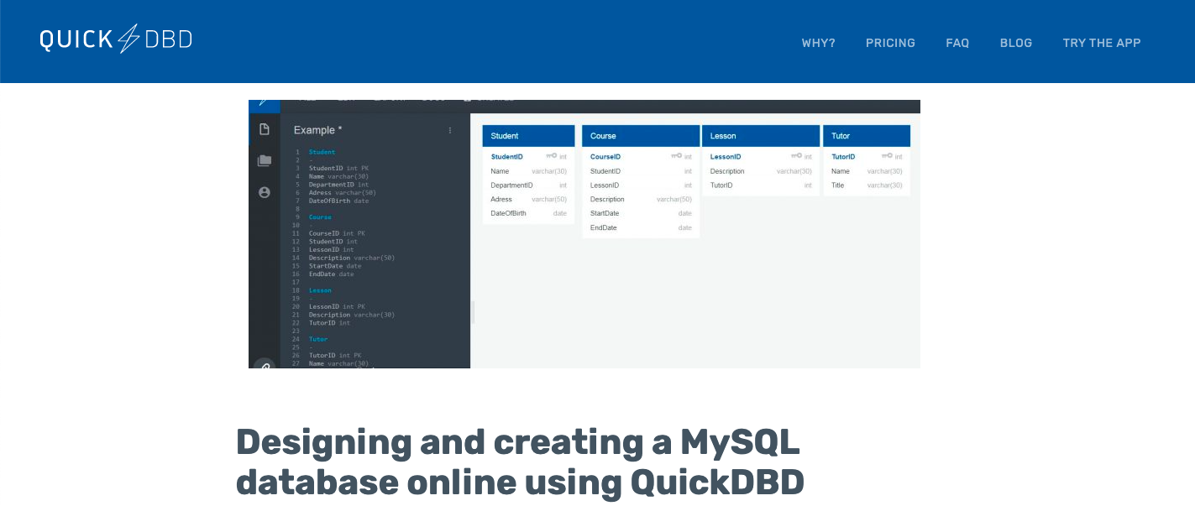
For this project I used a tool called ‘QuickDBD’ to sketch out the database design…

Slide 3

…MySQL to run queries…

Slide 4

…And Google Data Studio to build the dashboard

Slide 5

Project & Data Brief
Scenario:
Our client is a newly opened pizza shop. It won’t be a dining, more like a takeaway and delivery (e.g., like Dominos). The project brief requires us to design and build a tailor-made relational database for the business that will allow the manager to capture and store all the important information and data that the business generates. This will in turn help the management monitor business performance in dashboards and business reporting that we will also build.
The brief requires us to focus on 3 main areas:
Customer orders
Stock control
Staff

Slide 6

1. Database Design

Slide 7
Project & Data Brief - Continued
The client has different requirements for the data regarding the 3 main focus areas:
Orders data requirement:
Item name
Item price
Quantity
Customer name
Delivery address
Stock control requirements:
Wants to be able to know when it is time to order new stock
To do this we’re going to need more information about:
What ingredients go into each pizza
Their quantity based on the pizza size
The existing stock level
Staff data:
Wants to know which staff members are working when
Based on the staff salary information how much each pizza costs (ingredients + chefs + delivery)

Slide 8
Project & Data Brief - Continued
The client has different requirements for the data regarding the 3 main focus areas:
Orders data requirement:
Item name
Item price
Quantity
Customer name
Delivery address
Stock control requirements:
Wants to be able to know when it is time to order new stock
To do this we’re going to need more information about:
What ingredients go into each pizza
Their quantity based on the pizza size
The existing stock level
Staff data:
Wants to know which staff members are working when
Based on the staff salary information how much each pizza costs (ingredients + chefs + delivery)

Slide 9
Project & Data Brief
The client has different requirements for the data:
Orders data requirement:
Item name
Item price
Quantity
Customer name
Delivery address
What we need in our DB:
Row ID
Order ID
Item name
Item category
Item size
Item price
Quantity
Customer first name
Customer last name
Delivery address 1
Delivery address 2
Delivery city
Delivery zip code

Slide 10
…But such a table design leads to data redundancy and inefficiency as lots of data is getting repeated as seen from the Excel sample
What we need in our DB for the Orders table:
Row ID
Order ID
Item name
Item category
Item size
Item price
Quantity
Customer first name
Customer last name
Delivery address 1
Delivery address 2
Delivery city
Delivery zip code
Solution:
Normalization:
Reduces redundancy
Improves efficiency
However, this leads to:
Redundancy
Inefficiency

Slide 11
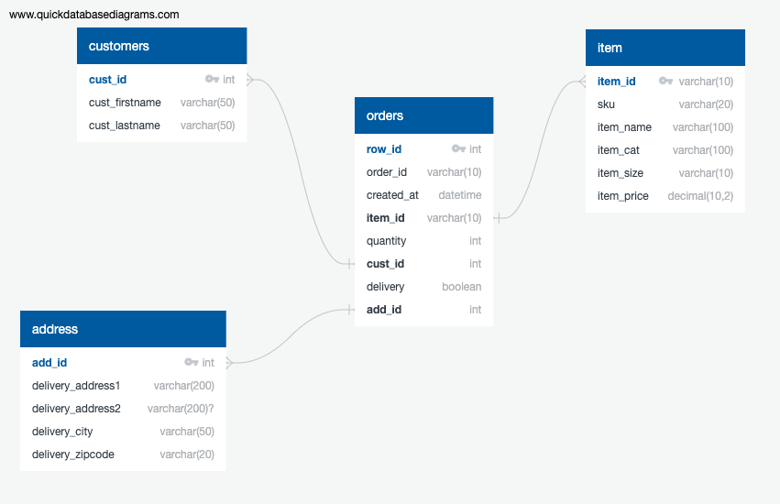
Normalization of Orders data

Slide 12
Project & Data Brief - Continued
The client has different requirements for the data regarding the 3 main focus areas:
Orders data requirement:
Item name
Item price
Quantity
Customer name
Delivery address
Stock control requirements:
Wants to be able to know when it is time to order new stock
To do this we’re going to need more information about:
What ingredients go into each pizza
Their quantity based on the pizza size
The existing stock level
Staff data:
Wants to know which staff members are working when
Based on the staff salary information how much each pizza costs (ingredients + chefs + delivery)

Slide 13
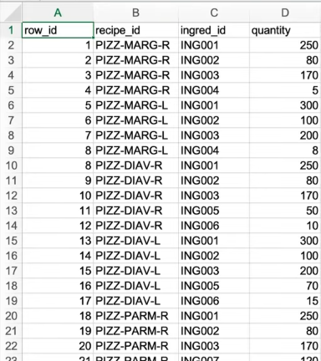
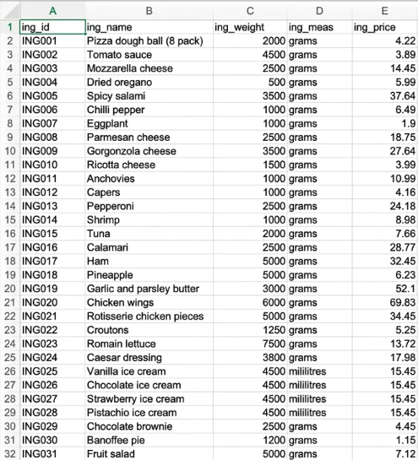
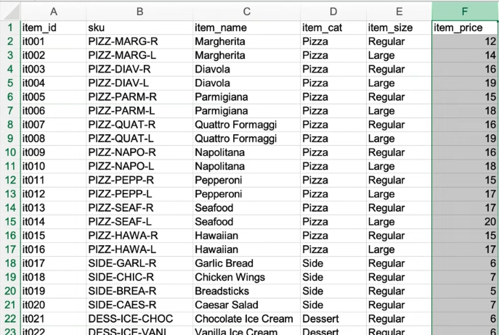
The client has provided following information regarding the items’ recipes and ingredients

Slide 14
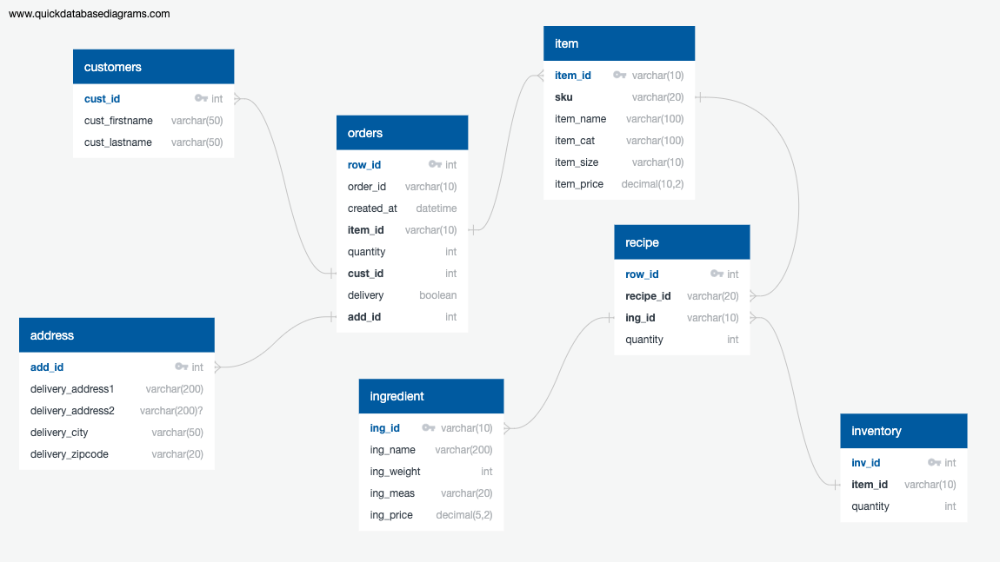
Normalization of Stock data

Slide 15
Project & Data Brief - Continued
The client has different requirements for the data regarding the 3 main focus areas:
Orders data requirement:
Item name
Item price
Quantity
Customer name
Delivery address
Stock control requirements:
Wants to be able to know when it is time to order new stock
To do this we’re going to need more information about:
What ingredients go into each pizza
Their quantity based on the pizza size
The existing stock level
Staff data:
Wants to know which staff members are working when
Based on the staff salary information how much each pizza costs (ingredients + chefs + delivery)

Slide 16
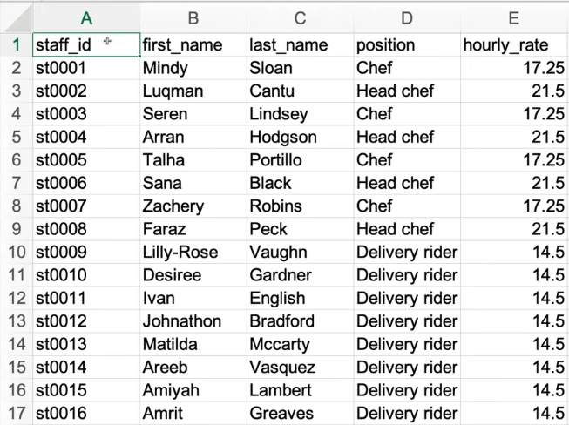
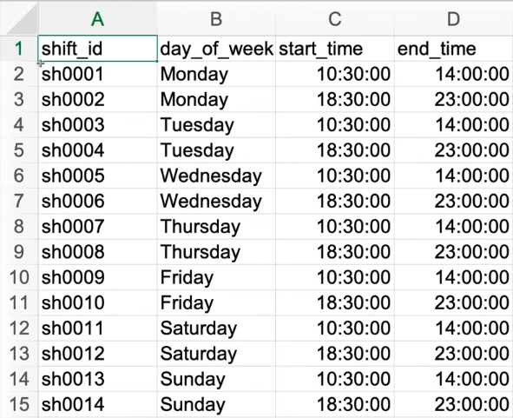
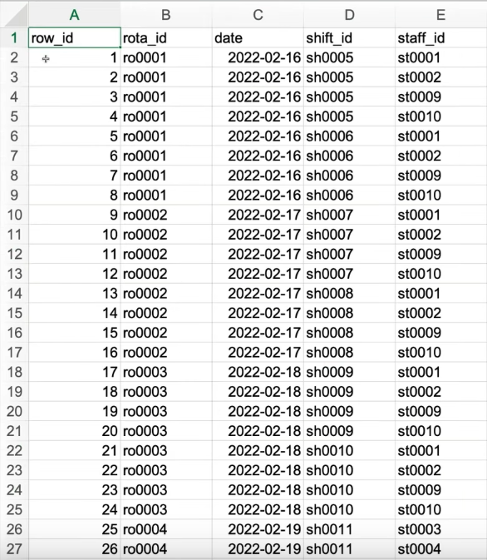
The client has provided following information on staff working hours and salary

Slide 17
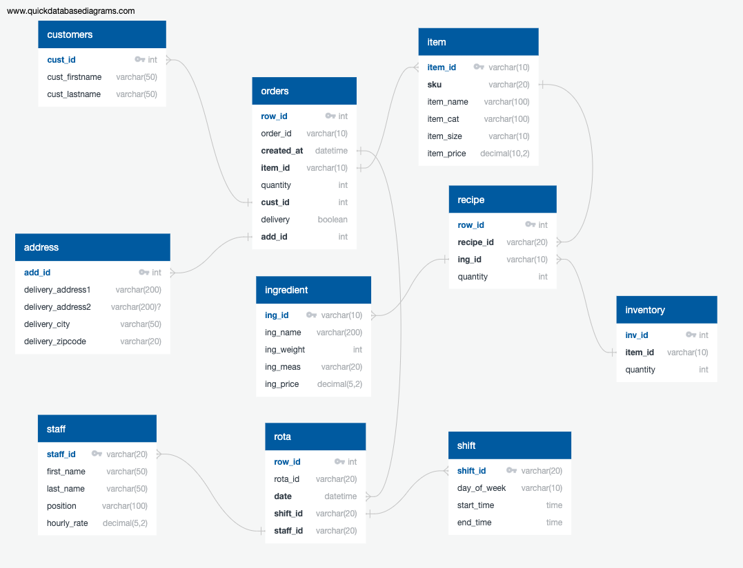
Normalization of Staff data

Slide 18
2. Creating custom SQL queries

Slide 19
Dashboard 1 - Order activity
Dashboard 1 - Order activity
For this, we will need a dashboard with the following data:
Total orders
Total sales
Total items
Average order value
Sales by category
Top selling items
Orders by hour
Sales by hour
Orders by address
Orders by delivery/pick-up

Slide 20
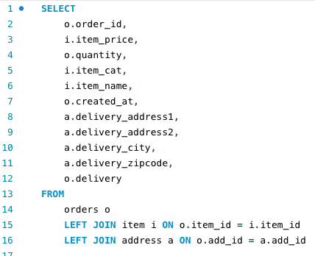
Query solution
Selects the columns we want to have
Joins orders table, item table & address table

Slide 21
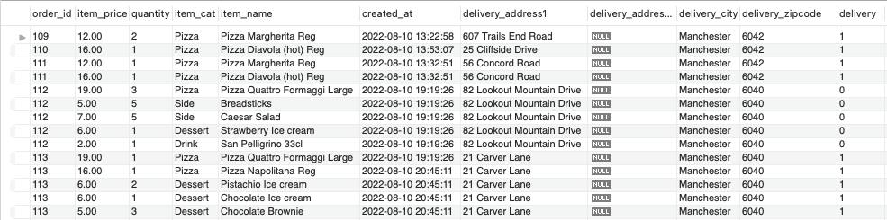
Result

Slide 22
Dashboard 2 – Inventory management
Dashboard 2 – Inventory management
This will be a lot more complicated than the orders. Mainly because we need to calculate how much inventory we’re using and then identify inventory that needs reordering. We also want to calculate how much each pizza costs to make based on the cost of the ingredients so we can keep an eye on pricing and P/L. Here is what we need:
Total quantity by ingredient
Total cost of ingredients
Calculated cost of pizza
Percentage stock remaining by ingredient
List of ingredients to re-order based on remaining inventory

Slide 23
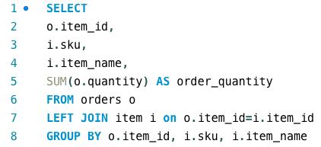
Query solution – 1/5

Slide 24
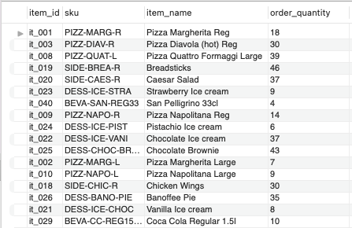
Result – 1/5
Returns number of orders per pizza – how many times was the given item ordered

Slide 25
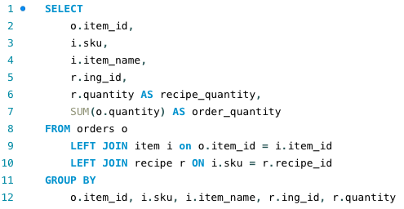
Query solution – 2/5

Slide 26
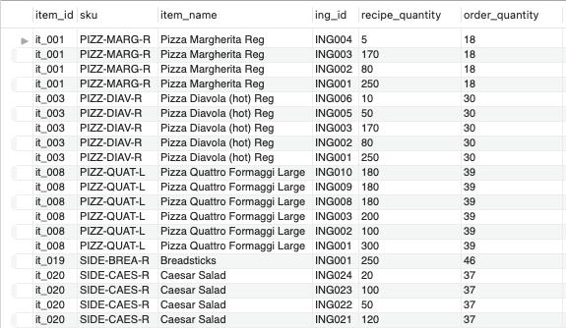
Result – 2/5
Now we can see the breakdown by ingredient ID as well

Slide 27
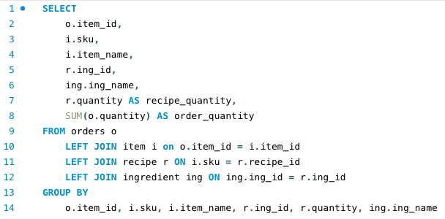
Query solution – 3/5

Slide 28
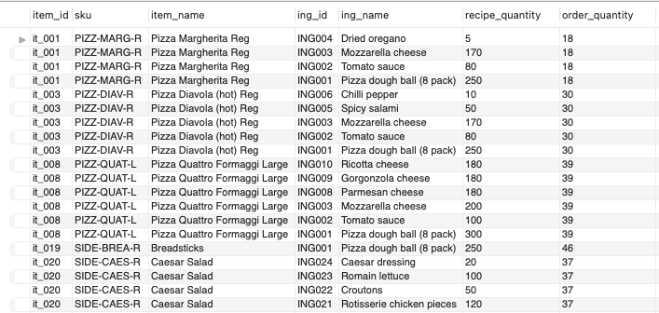
Result – 3/5
Using this result, we can now calculate the total quantity of ingredients

Slide 29
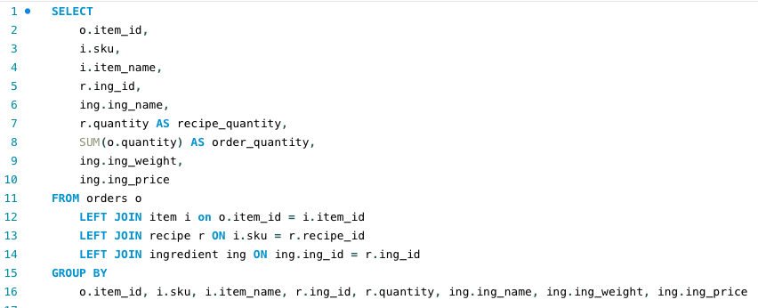
Query solution – 4/5
Now we want to be able to calculate the total cost of ingredients. We already have the quantity so if we can get a unit cost for each ingredient, we can multiply this by number of units i.e., the weight, which is available to us in the ingredient table

Slide 30
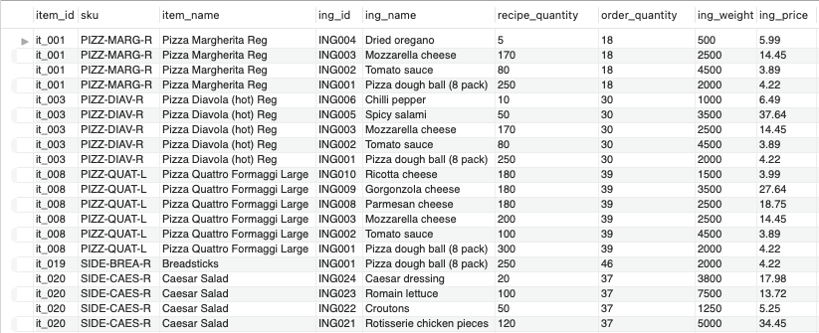
Result – 4/5

Slide 31
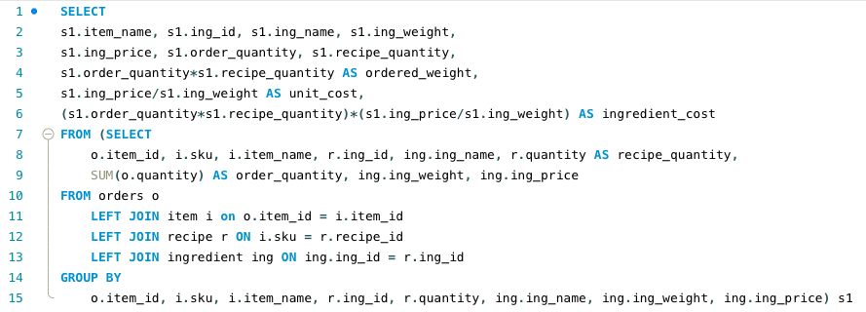
Query solution – 5/5
As we want to multiply order_quantity by recipe_quantity we need to put the whole thing into a sub-query as order_quantity is already an aggregated field so it can not be used in the same select statement for the calculation we need to do. We can now calculate ordered weight, unit cost & ingredient cost like this:

Slide 32
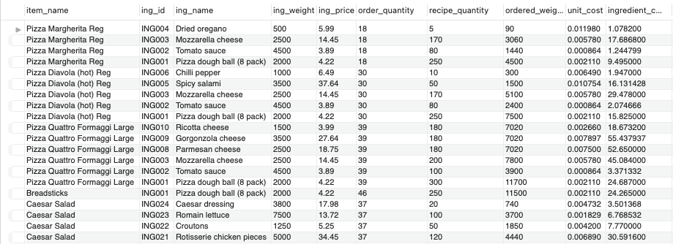
Result – 5/5

Slide 33
Dashboard 2 – Inventory management
Dashboard 2 – Inventory management
This will be a lot more complicated than the orders. Mainly because we need to calculate how much inventory we’re using and then identify inventory that needs reordering. We also want to calculate how much each pizza costs to make based on the cost of the ingredients so we can keep an eye on pricing and P/L. Here is what we need:
Total quantity by ingredient
Total cost of ingredients
Calculated cost of pizza
Percentage stock remaining by ingredient
List of ingredients to re-order based on remaining inventory

Slide 34
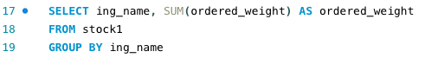
Query solution – 1/4
Stock1 is a view of the columns and queries we worked with before. This will return the total weight ordered by ingredient.

Slide 35
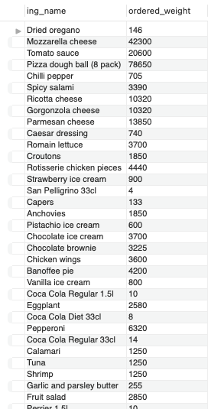
Result – 1/4

Slide 36
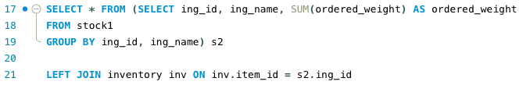
Query solution – 2/4
What we need now is the total weight of inventory for each ingredient we started with.

Slide 37
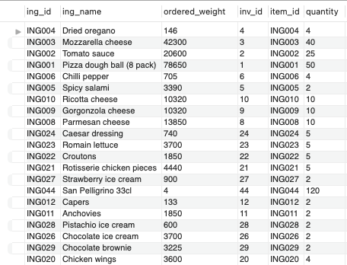
Result – 2/4
Now we have the quantity for each ingredient in stock

Slide 38
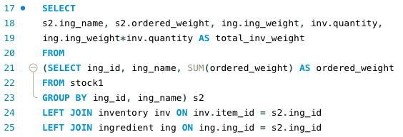
Query solution – 3/4
We also need to add in the total weight in stock from the ingredients table. That will be the quantity*weight that each ingredient is bought in.
ing_weight*quantity = total_inv_weight

Slide 39
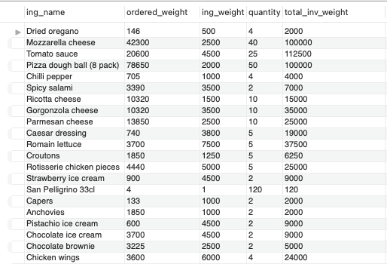
Result – 3/4

Slide 40
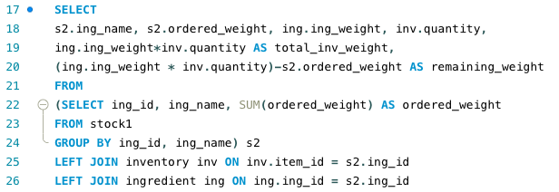
Query solution – 4/4
The last thing regarding the inventory queries is to calculate total inventory weight minus the ordered weight as remaining weight.

Slide 41
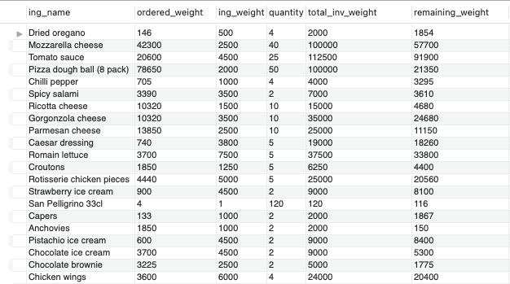
Result – 4/4

Slide 42
Dashboard 3 – Staff
Staff data:
Wants to know which staff members are working when
Based on the staff salary information how much each pizza costs (ingredients + chefs + delivery)

Slide 43
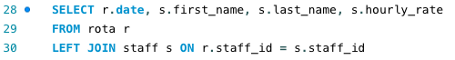
Query solution – 1/3

Slide 44
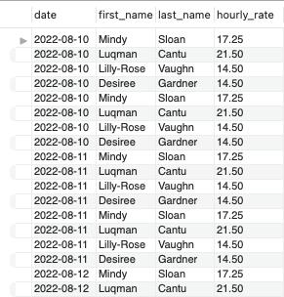
Result – 1/3

Slide 45
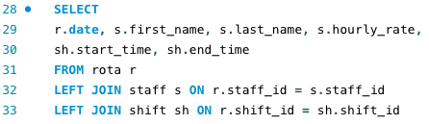
Query solution – 2/3

Slide 46
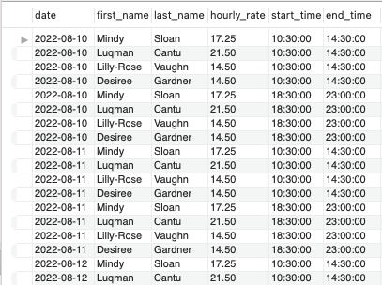
Result – 2/3

Slide 47
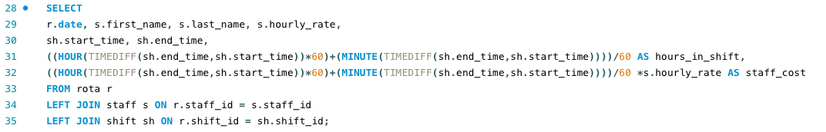
Query solution – 3/3
Now we want to calculate the staff cost per row. This involves calculating the number of hours in each shift and multiply this by the hourly rate. The TIMEDIFF function will be used, turning the result in to a total number of minutes and then dividing this by 60 to get the number of hours as a decimal. Then this number will be multiplied by the hourly rate.
hours_in_shift = difference between start hour and end hour. Multiplied by 60 to turn it into minutes. Then to this I add the difference between start and end minutes. This gives a total minutes that I divide by 60 to get the decimal hours. To get the staff cost I multiply row 31 with s.hourly_rate from the table.

Slide 48
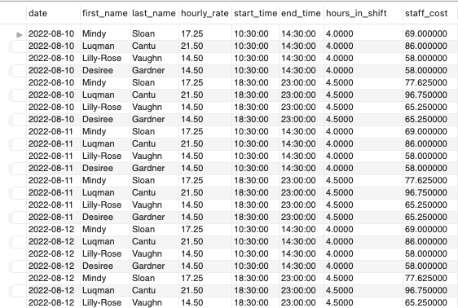
Result – 3/3

Slide 49
We now have everything we need to move on to our visualization software and create the dashboards!

Slide 50
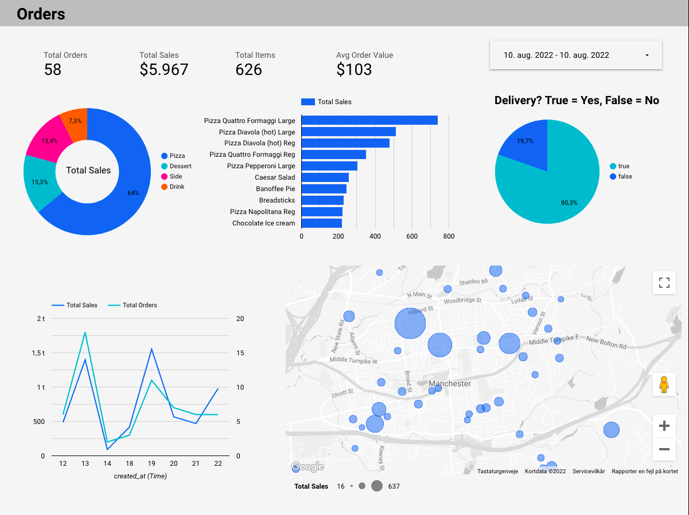
Orders Dashboard

Slide 51
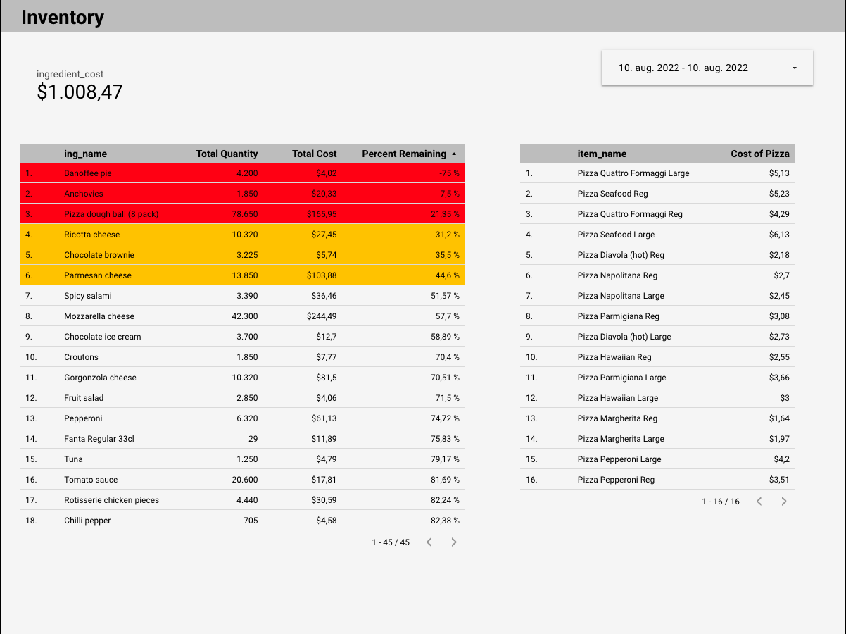
Inventory Dashboard

Slide 52
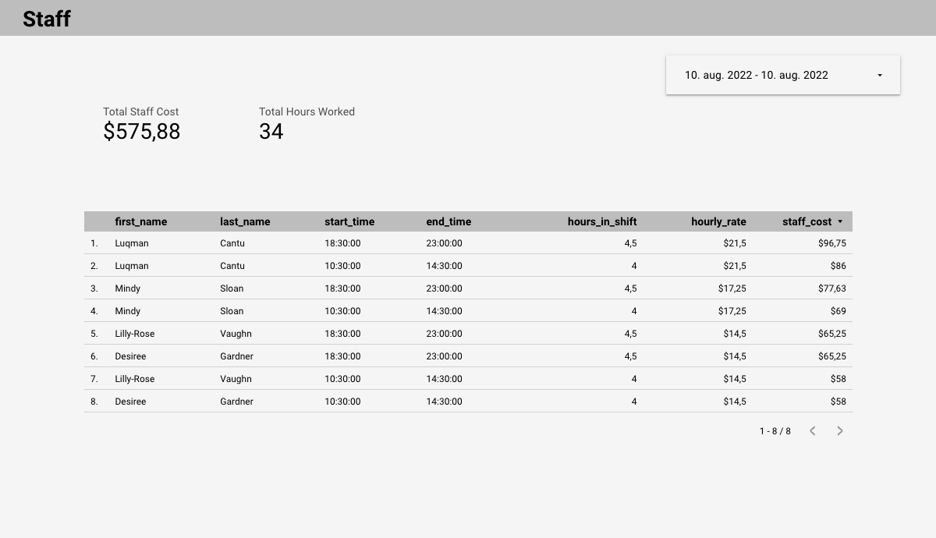
Staff Dashboard

Slide 53
Access dashboard at: https://datastudio.google.com/reporting/bf605e82-8fe1-45c5-98c7-ca35ccc4e7cf

Slide 54



Thank You!

